Slide 2
AGENDA
What’s RxJS
Observable
Create an Observable
Subscribing to Observables
Operators
Subject

Slide 3

WHATS’S RXJS
“RxJS is a library for composing asynchronous and event-based programs by using observable sequences.” ——reactivex.io/rxjs

Slide 4
Observable
Observables are able to produce data either synchronously or asynchronously.

Slide 5
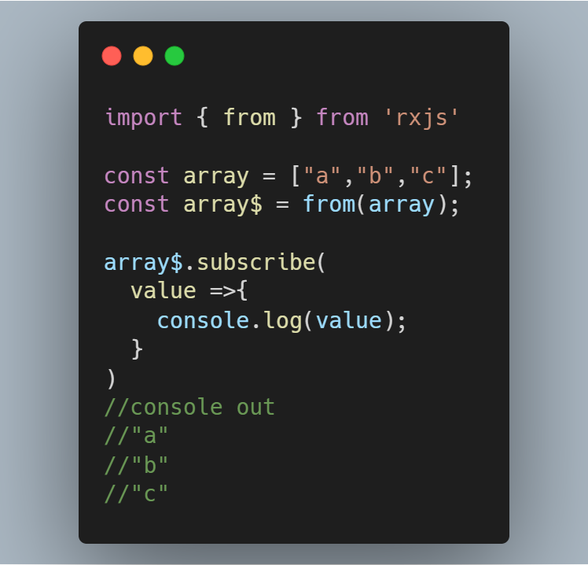
CREATE AN OBSERVABLE
from()
of()
fromEvent()
timer()
Interval()

Slide 6
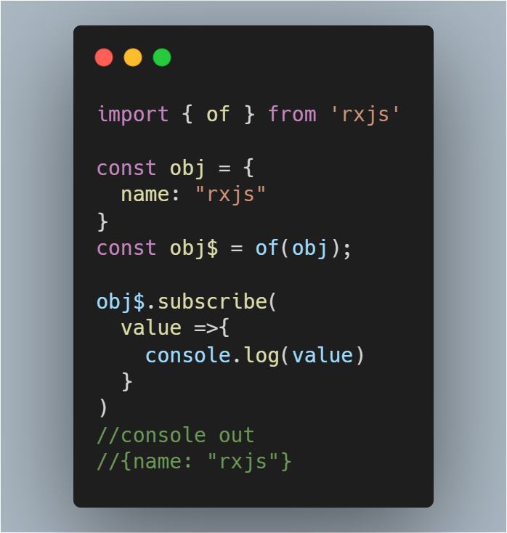
CREATE AN OBSERVABLE
from()
of()
fromEvent()
timer()
Interval()

Slide 7
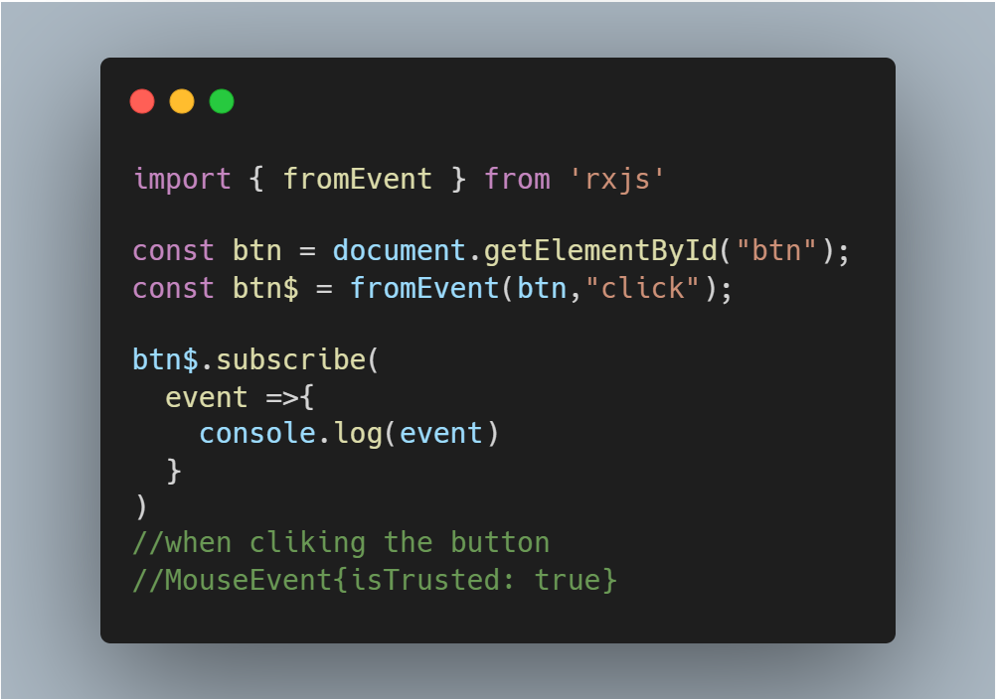
CREATE AN OBSERVABLE
from()
of()
fromEvent()
timer()
Interval()

Slide 8
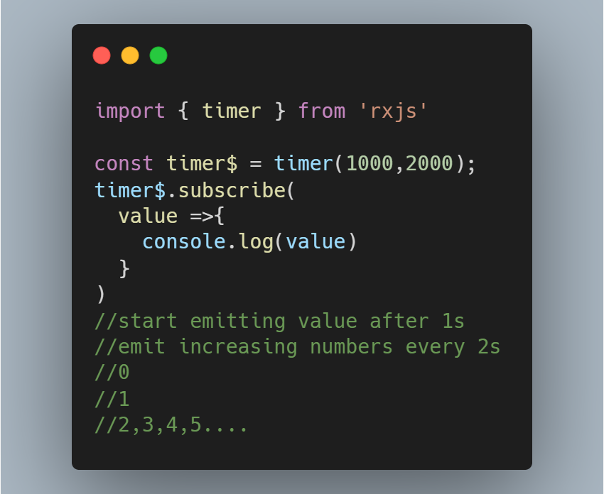
CREATE AN OBSERVABLE
from()
of()
fromEvent()
timer()
Interval()

Slide 9
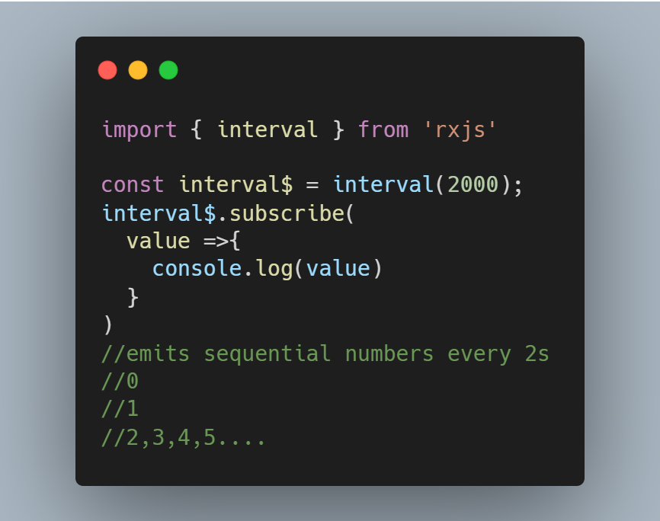
CREATE AN OBSERVABLE
from()
of()
fromEvent()
timer()
Interval()

Slide 10
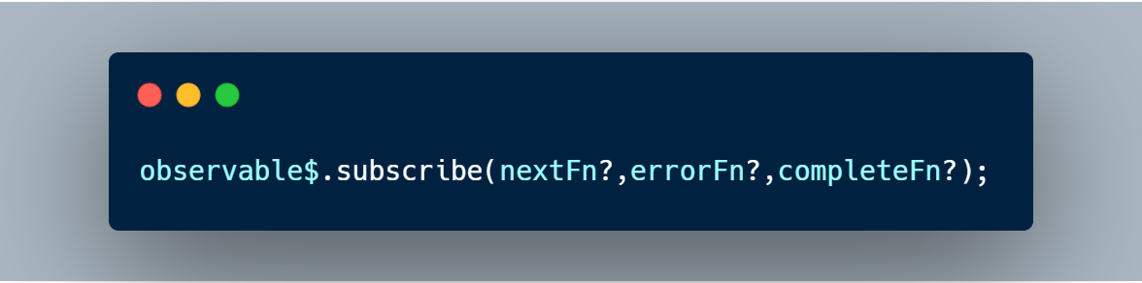
Subscribing to Observables
The observable’s subscribe method allows you to pass three callback methods as parameters.
Whenever the data arrives, the nextFn will be invoked to process the data.
Before the data arrives if an exception happens, the errorFn will be invoked to handle the error.
When all the data has been emitted successfully, the completeFn will be invoked.
If error occurred, the afterwards data will not be delivered and the completeFn will be not invoked.

Slide 11
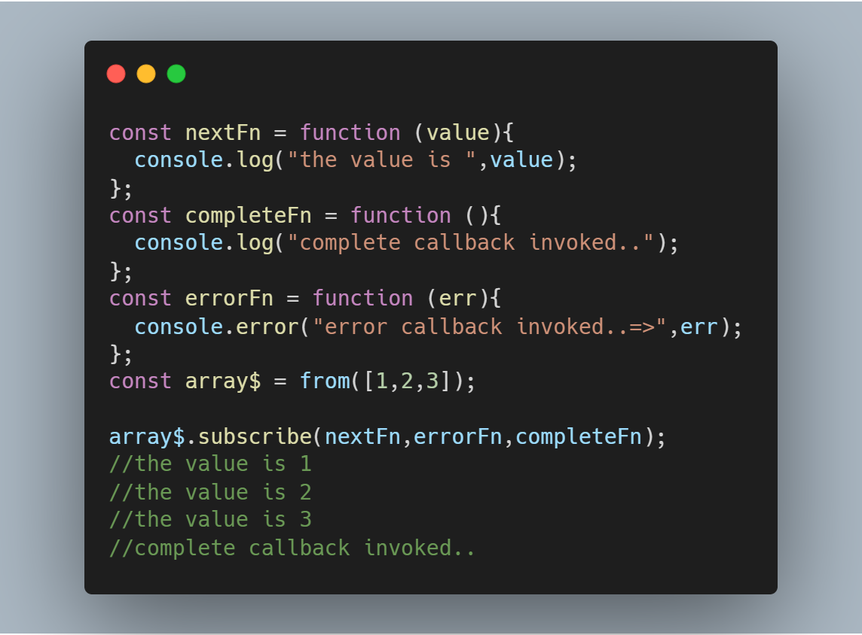
Subscribing to Observables

Slide 12
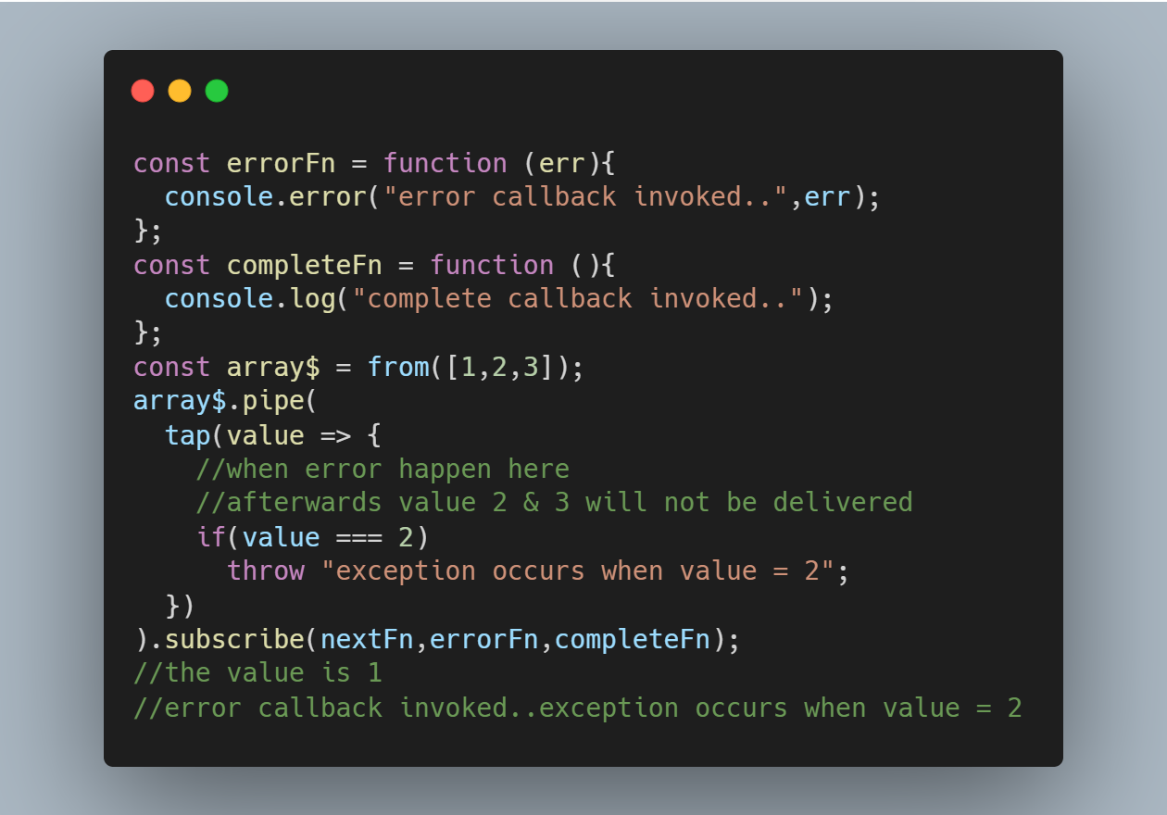
Subscribing to Observables

Slide 13
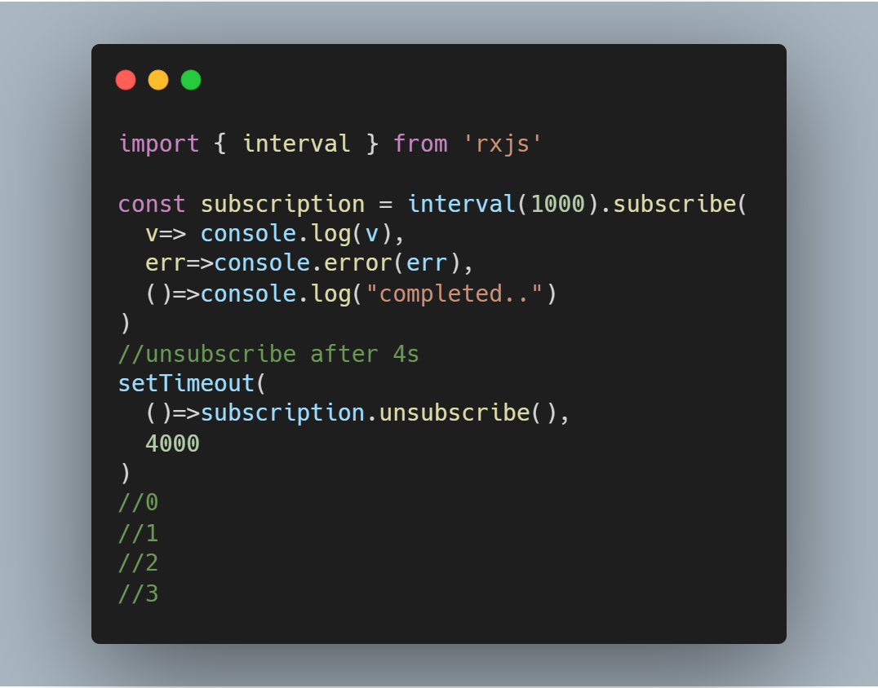
What is a Subscription?
A Subscription is an object that represents the execution of an Observable.
A Subscription has an unsubscribe() function to release resources or cancel Observable executions.

Slide 14
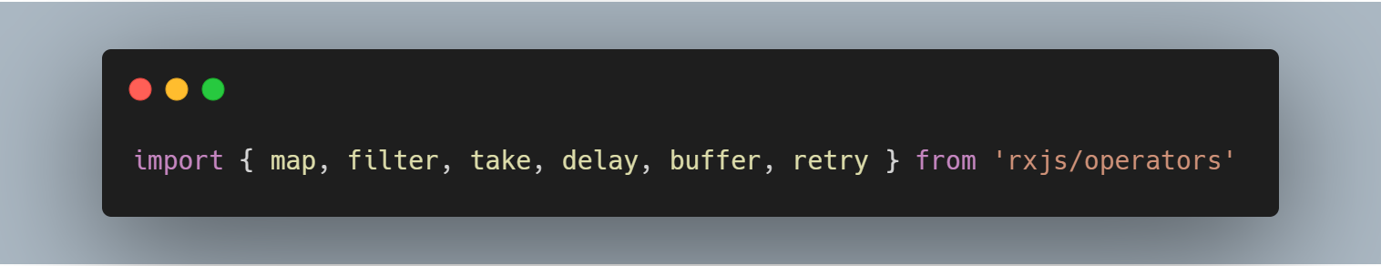
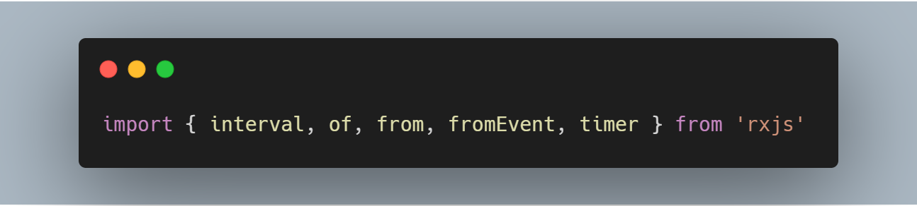
Operators
Pipeable Operator
Creation Operator

Slide 15
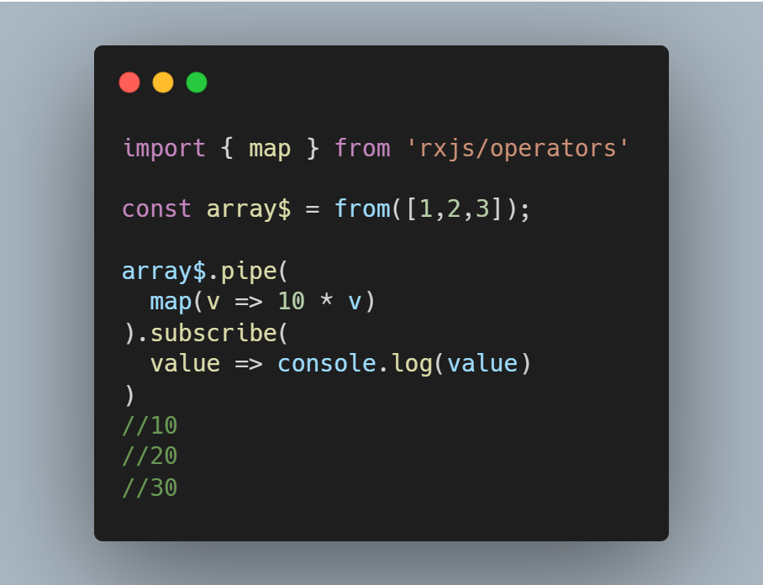
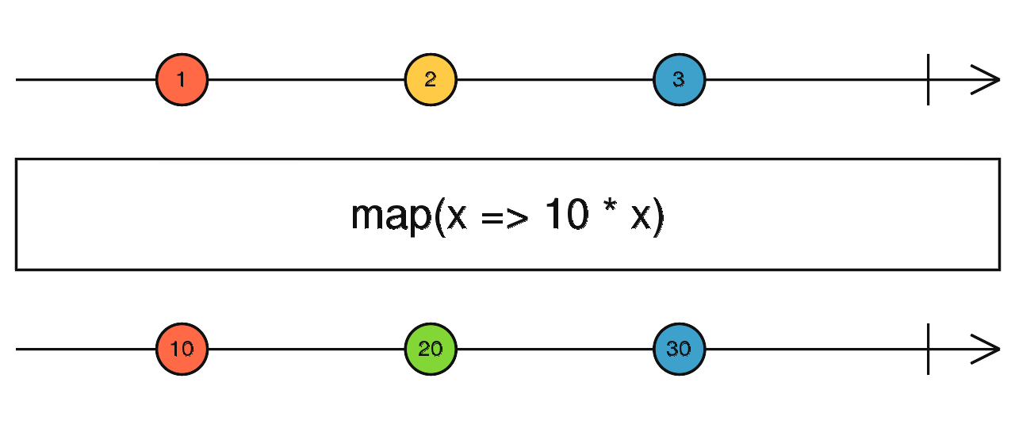
Operators
map()

Slide 16
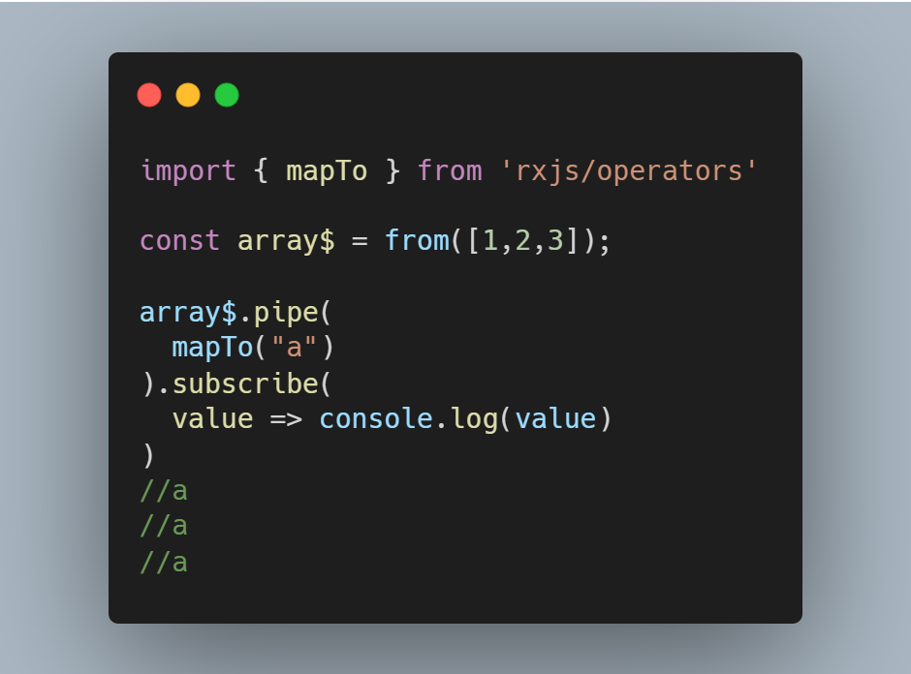
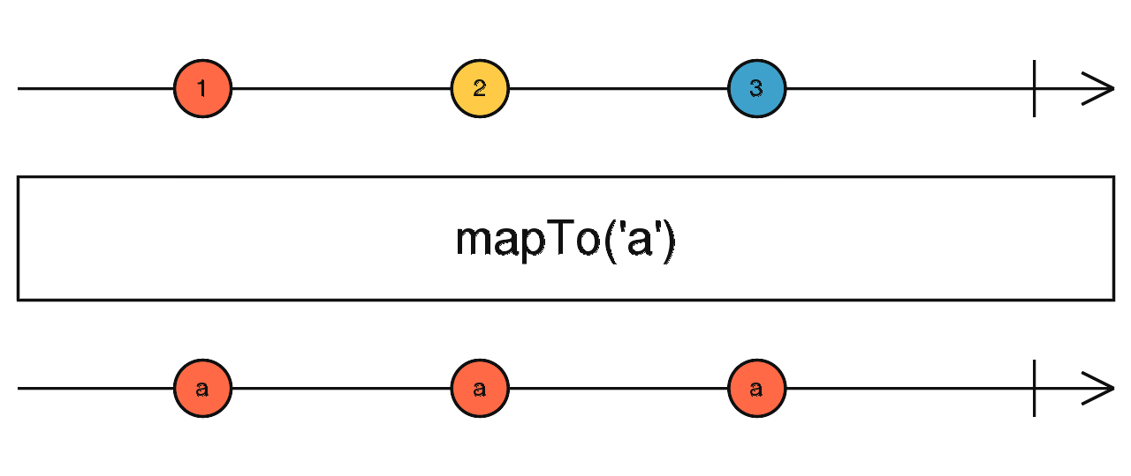
Operators
mapTo()

Slide 17
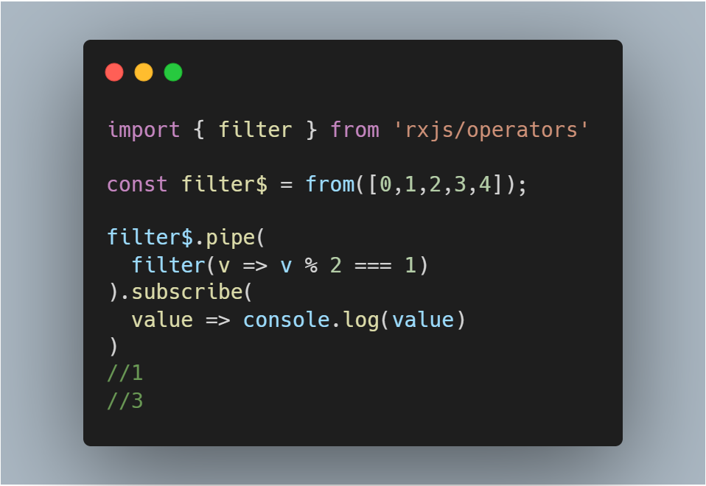
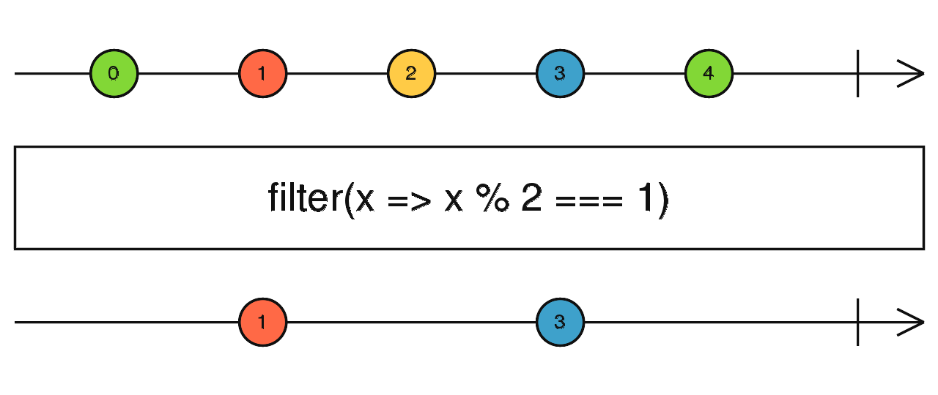
Operators
filter()

Slide 18
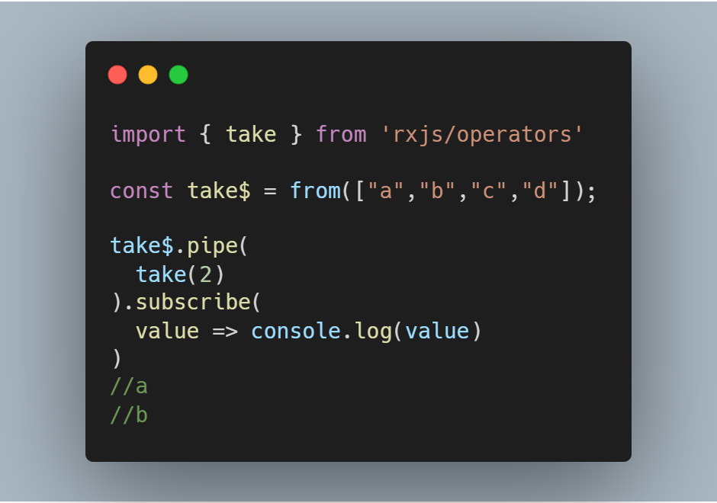
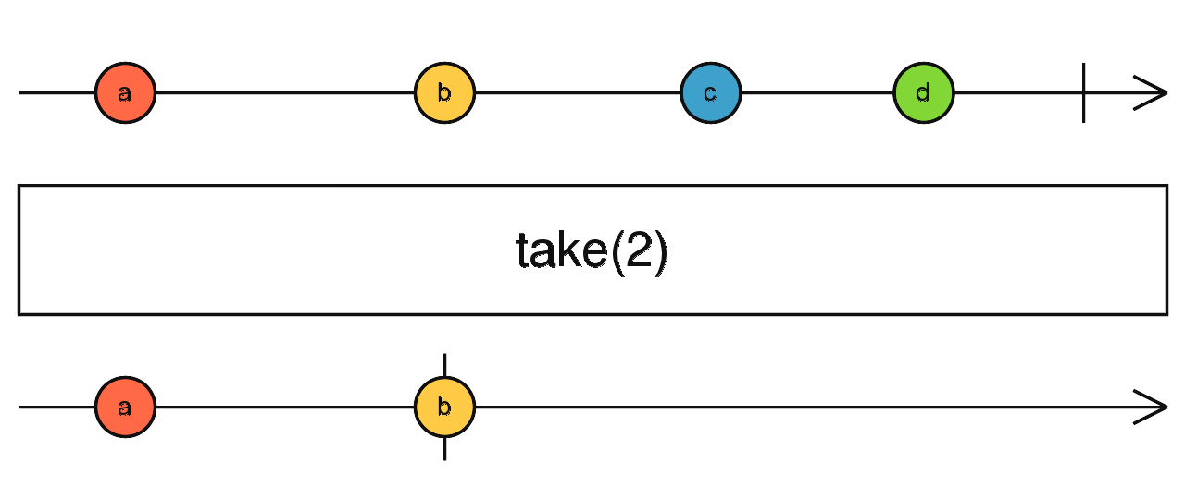
Operators
take()

Slide 19
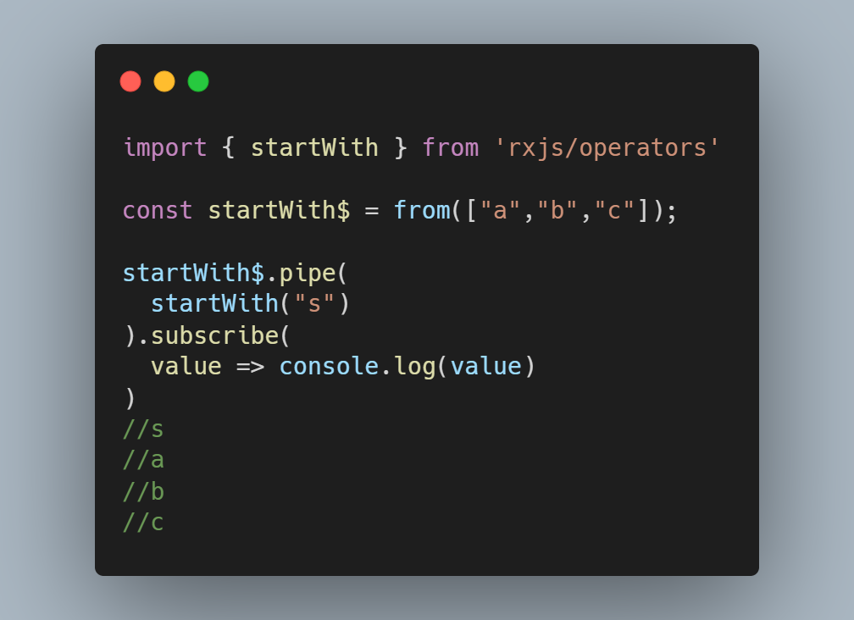
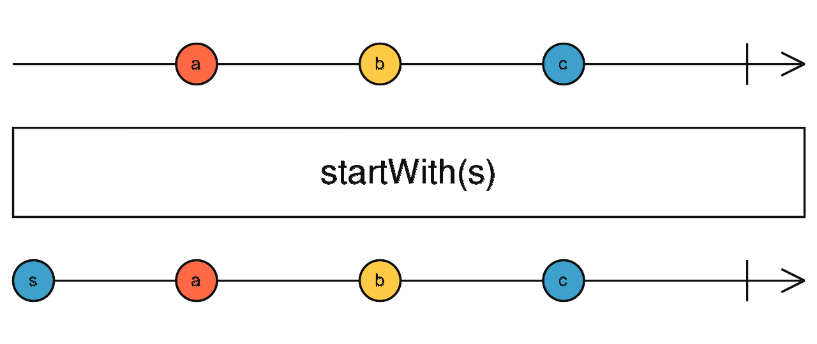
Operators
startWith()

Slide 20
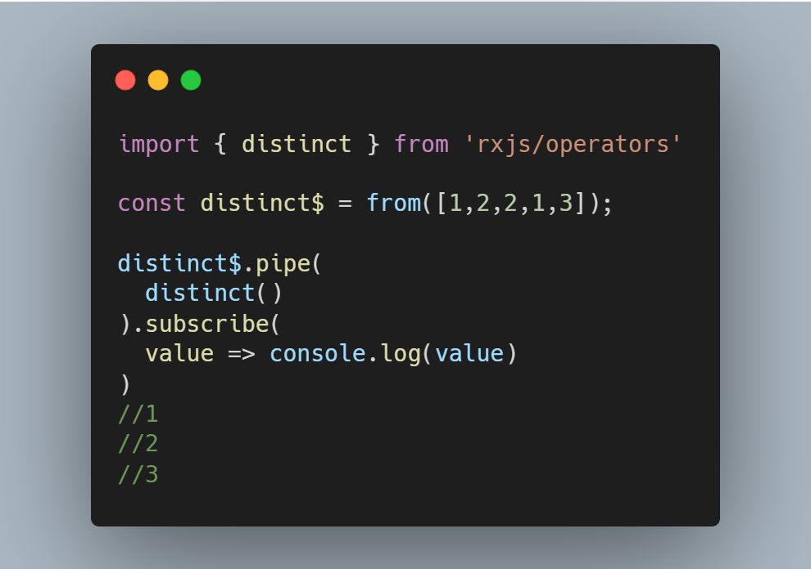
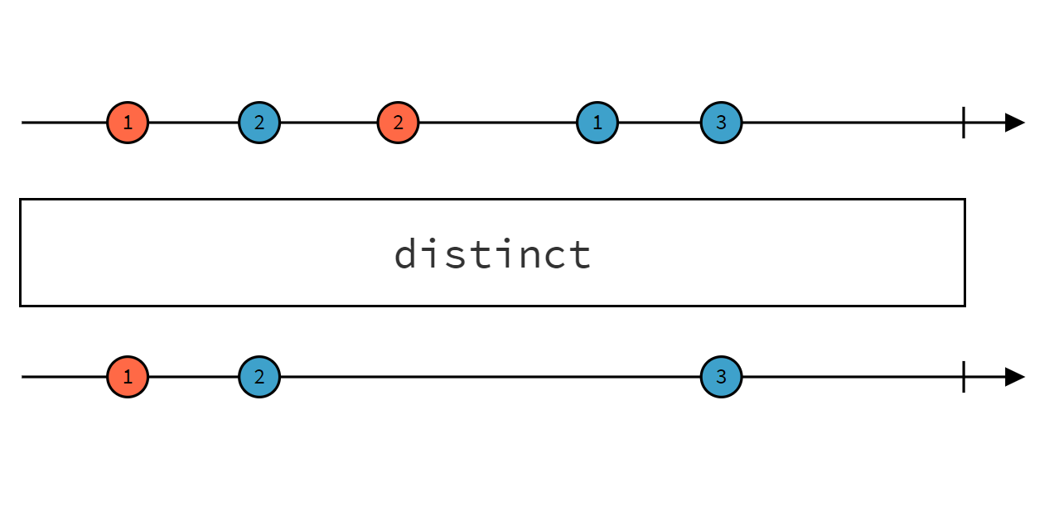
Operators
distinct()

Slide 21
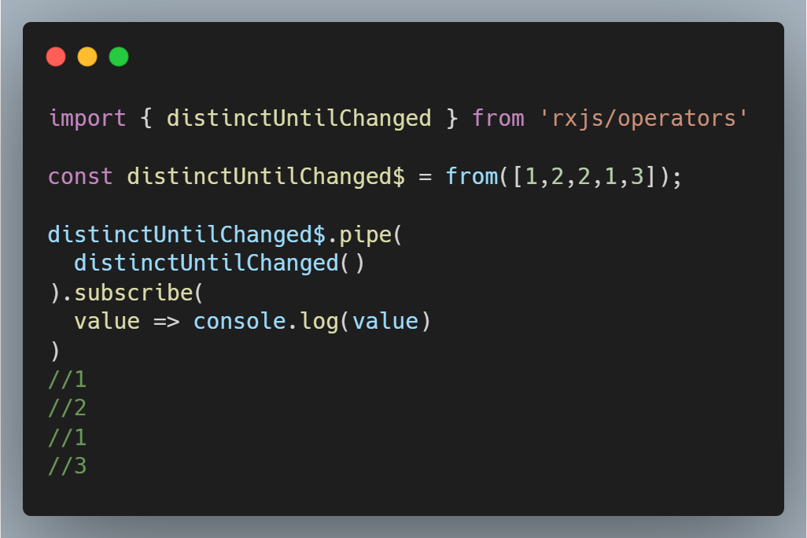
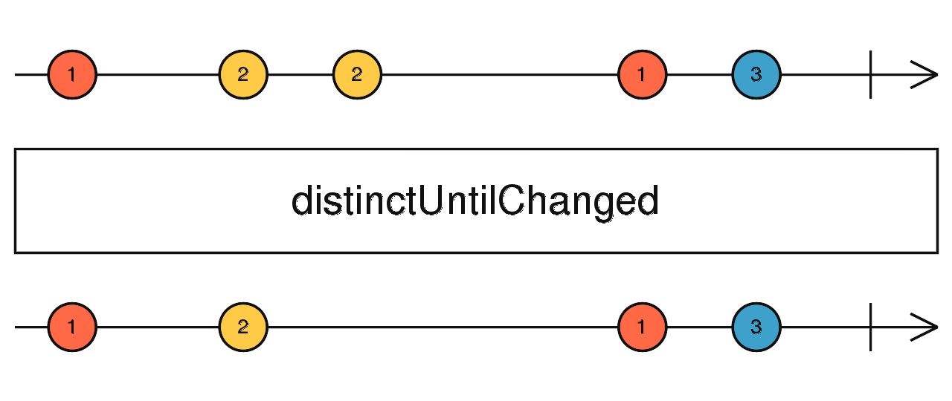
Operators
distinctUntilChanged()

Slide 22
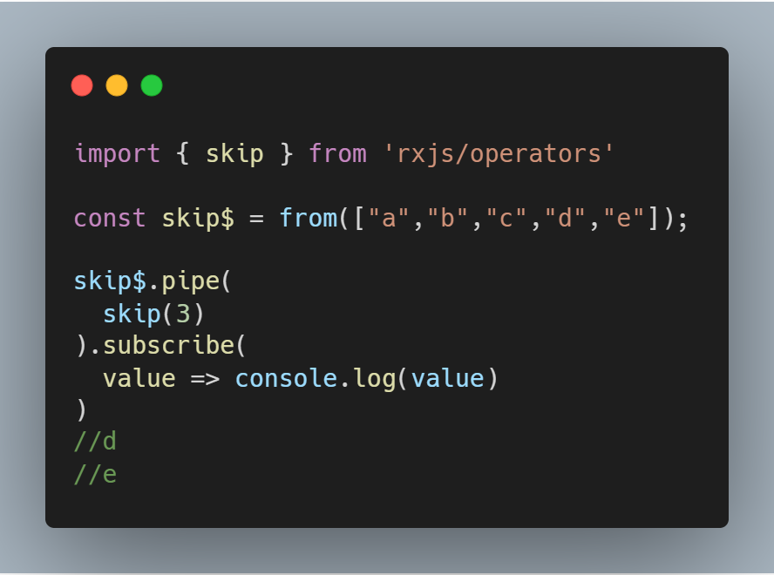
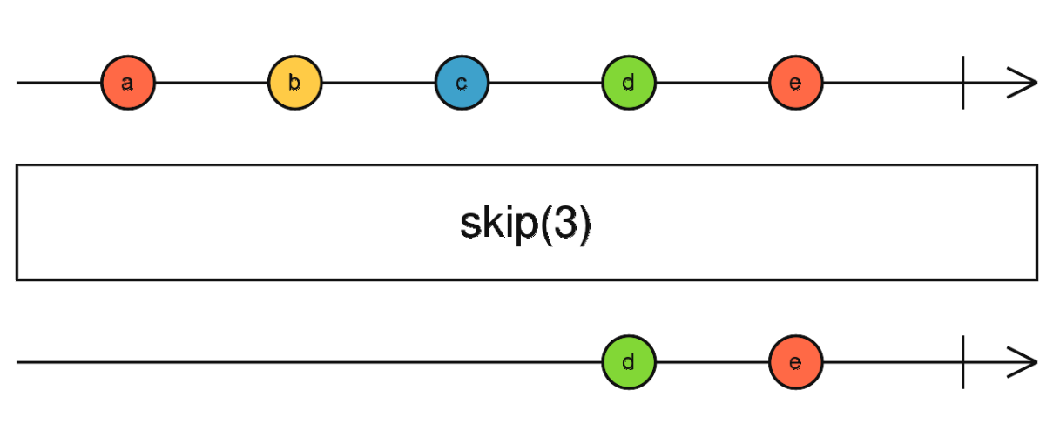
Operators
skip()

Slide 23
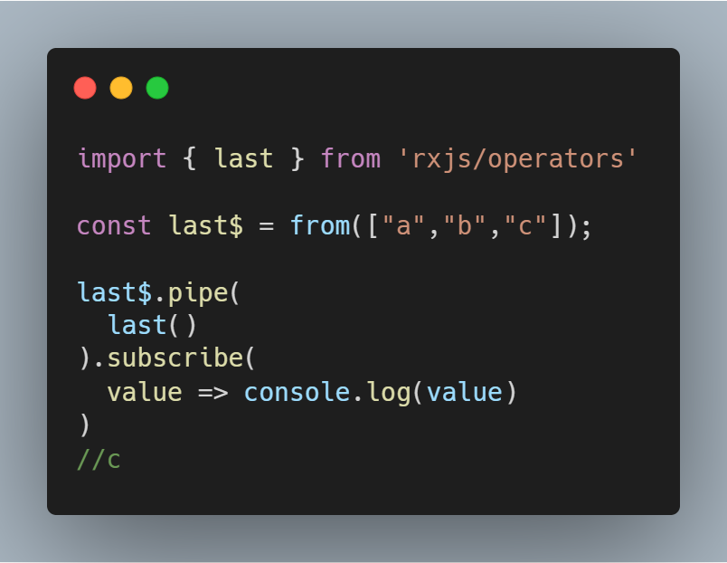
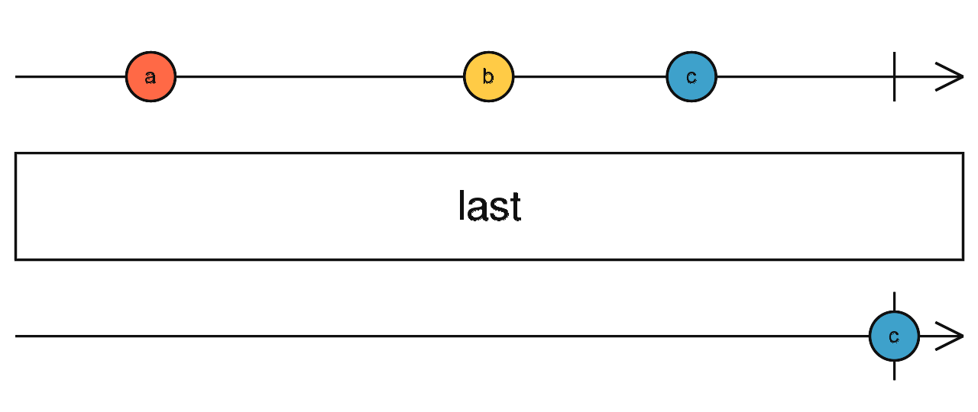
Operators
last()

Slide 24
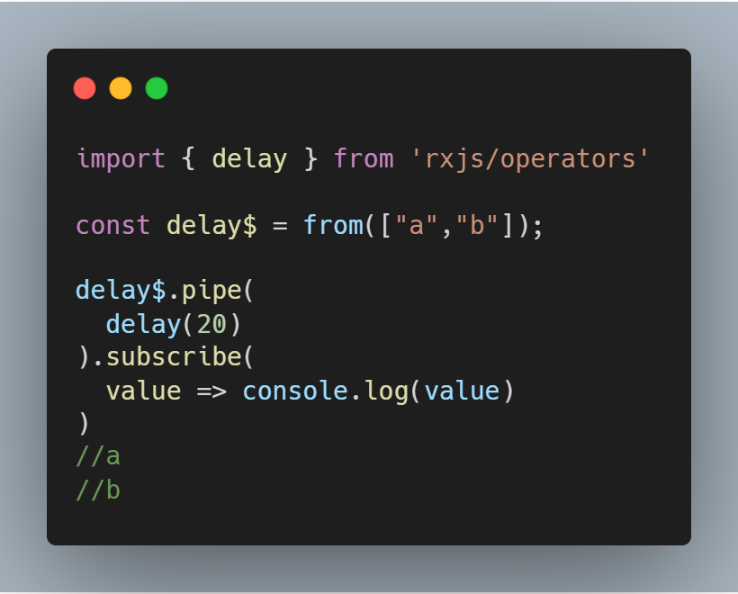
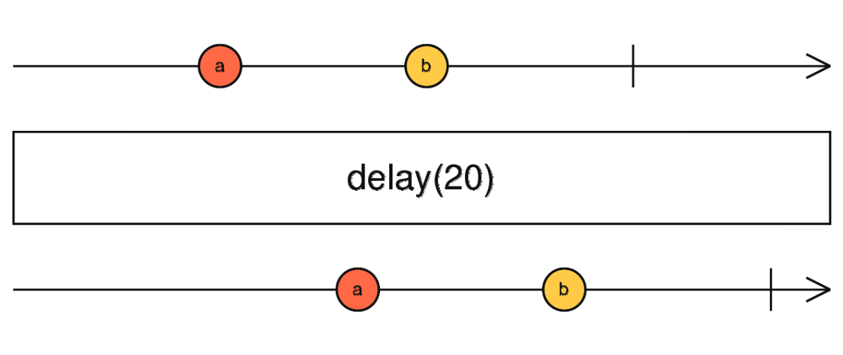
Operators
delay()

Slide 25
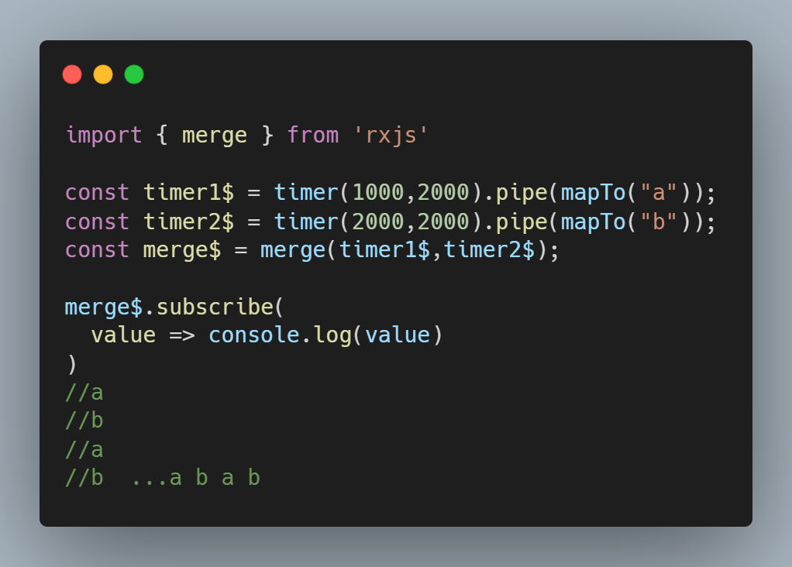
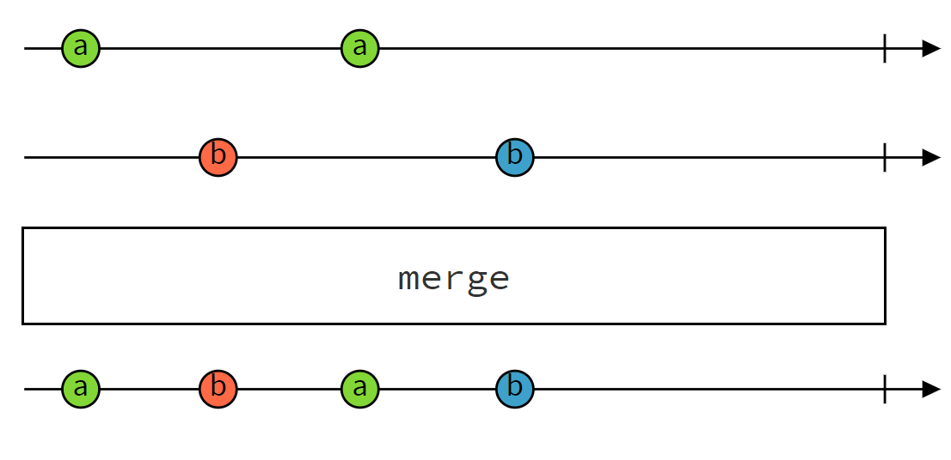
High-Level Operators
merge()

Slide 26
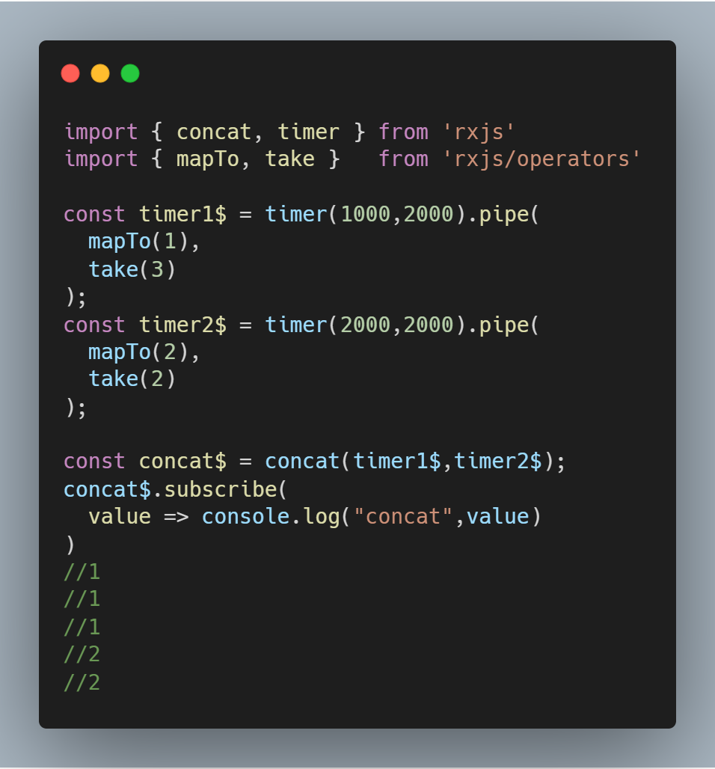
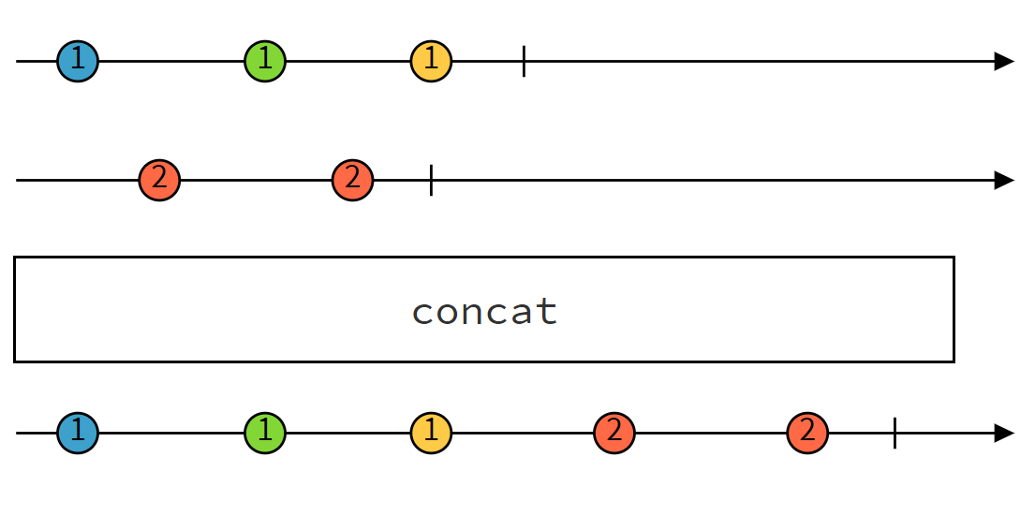
High-Level Operators
concat()

Slide 27
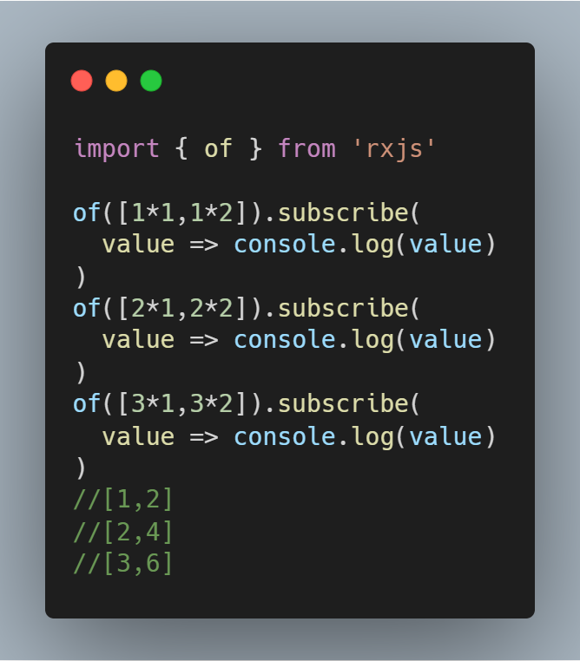
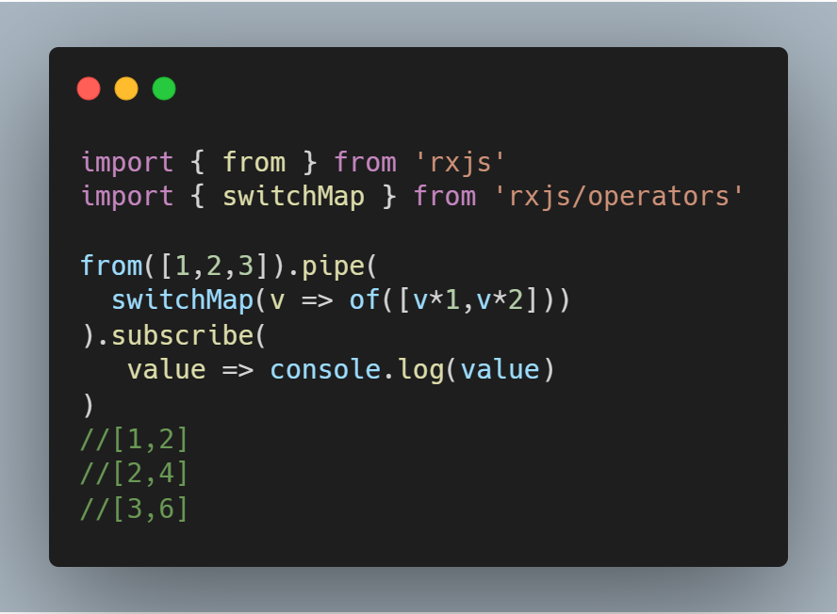
High-Level Operators
switchMap()
Maps each value to an inner Observable

Slide 28
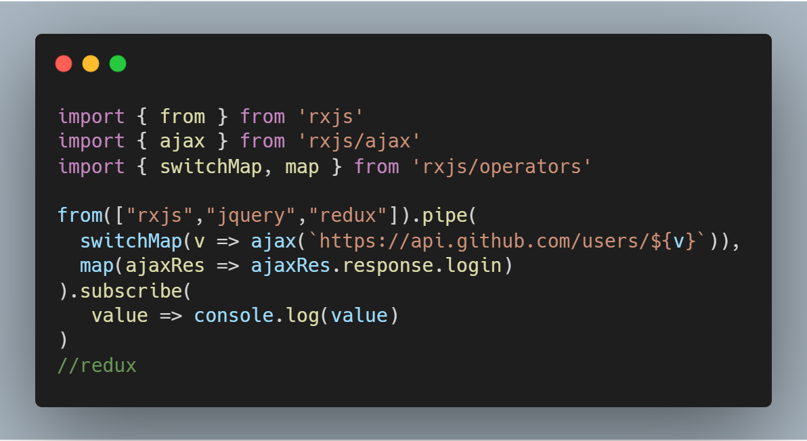
High-Level Operators
switchMap()
Cancel previous uncomplete inner Observable

Slide 29
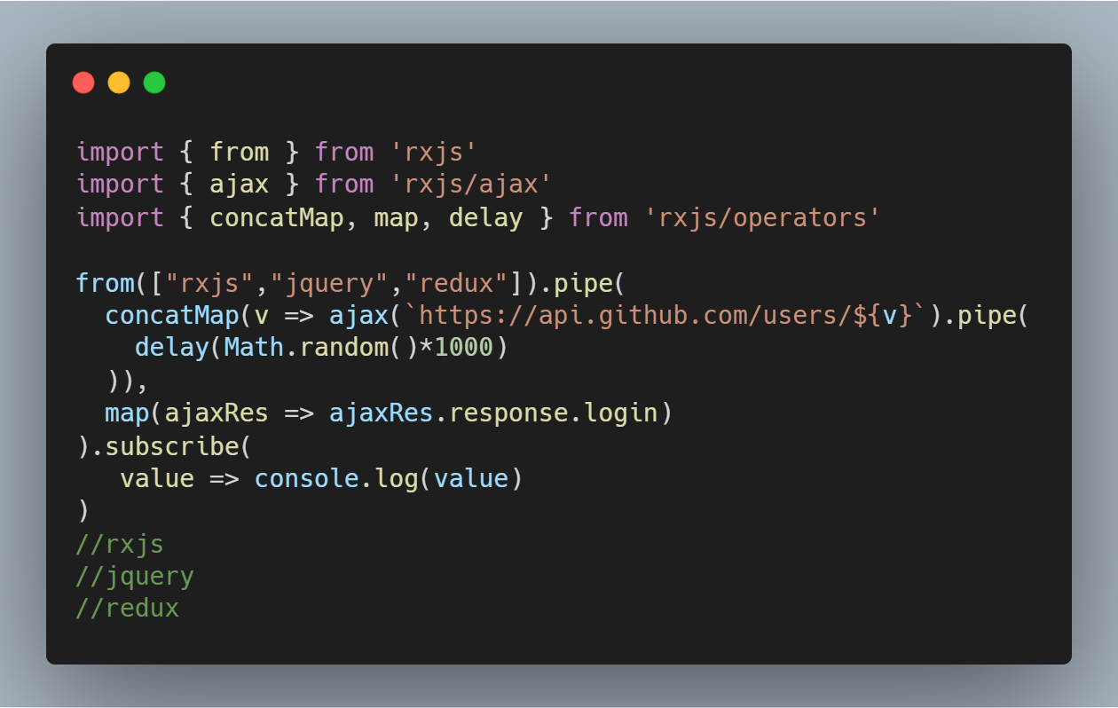
High-Level Operators
concatMap()
Map each value to inner observable, subscribe and emit in order.

Slide 30
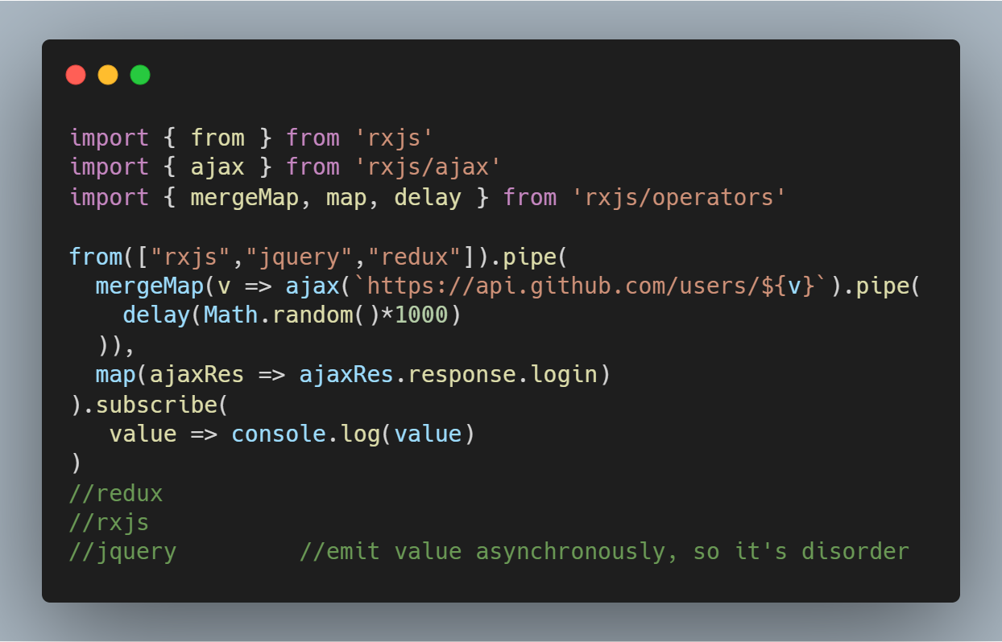
High-Level Operators
mergeMap() / flatMap()
Map each value to inner observable, subscribe and emit asynchronously.

Slide 31
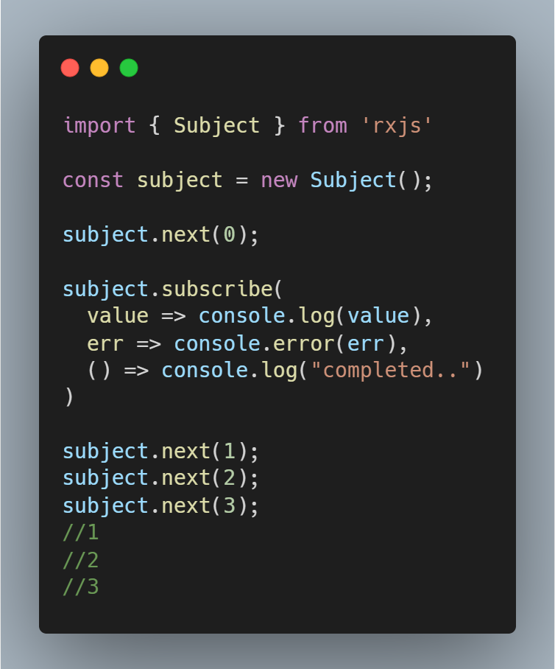
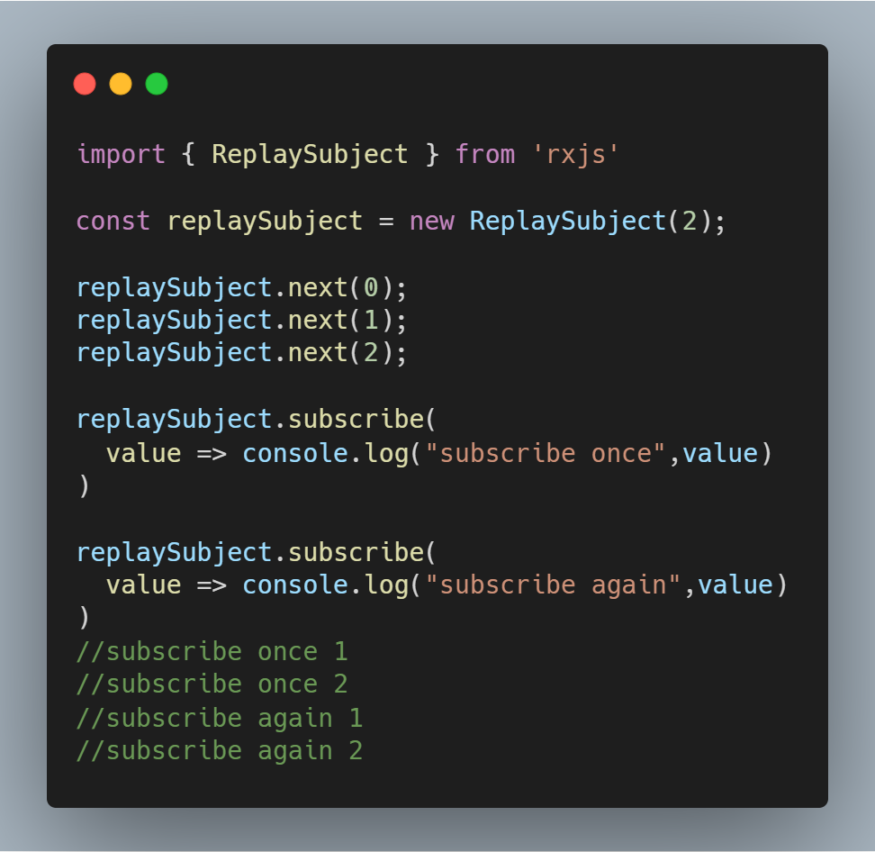
Subject
Every Subject is an Observable and an Observer. You can subscribe to a Subject, and you can call next to feed values as well as error and complete.

Slide 32
Live demo resources
Create Observables
Subscribe to an Observable
Operators
High-Level operators
Subject

Slide 33

Thanks！

